Slide 1

HoloNav: Touchless Gesture & Voice Control
Like Iron Man's J.A.R.V.I.S – Control without Touch!
━━━━━━━━━━━━━━━━━
Develop by : 👨‍💻 Samyak Khandare
━━━━━━━━━━━━━━━━

Slide 2

Introduction
Technology is moving towards touchless control and automation. Our project, HoloNav – The Iron Man Workflow in Action, is inspired by futuristic interaction systems where users can control applications using hand gestures, voice commands, and automation without physically touching devices.
✨ Gesture Recognition – Control apps with simple hand movements
✨ Voice Commands – Speak naturally to open apps, websites, or files
✨ Automation – Perform tasks faster with AI-powered workflow
This project is designed to be easy, futuristic, and interactive, showing how humans and technology can work together smoothly.

Slide 3
The Problem: Free and Easy Control
Limited by keyboards, mouse, and remotes
We always use keyboards, mouse, or remotes to control media, which doesn’t feel natural."
Same actions again and not clean
Using devices too much by touch is boring and not hygienic in shared places
The Future Tech Dream
Imagine smooth control, like J.A.R.V.I.S, using just your hands and voice

Slide 4
Our Goal: New Way to Interact
Effortless Media Control
Make interacting with your digital world intuitive, engaging, and entirely touchless
Move and Control with Gestures
Touch-free and easy interaction
Give Commands by Speaking
Open apps & play music with your voice

Slide 5
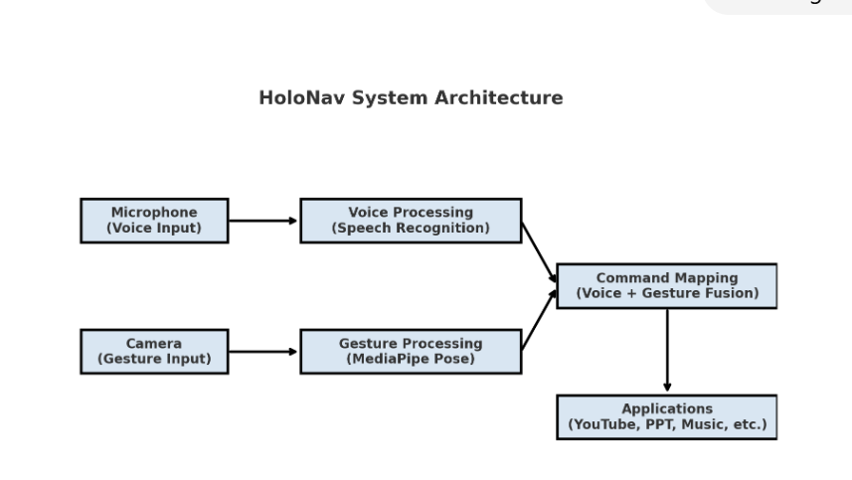
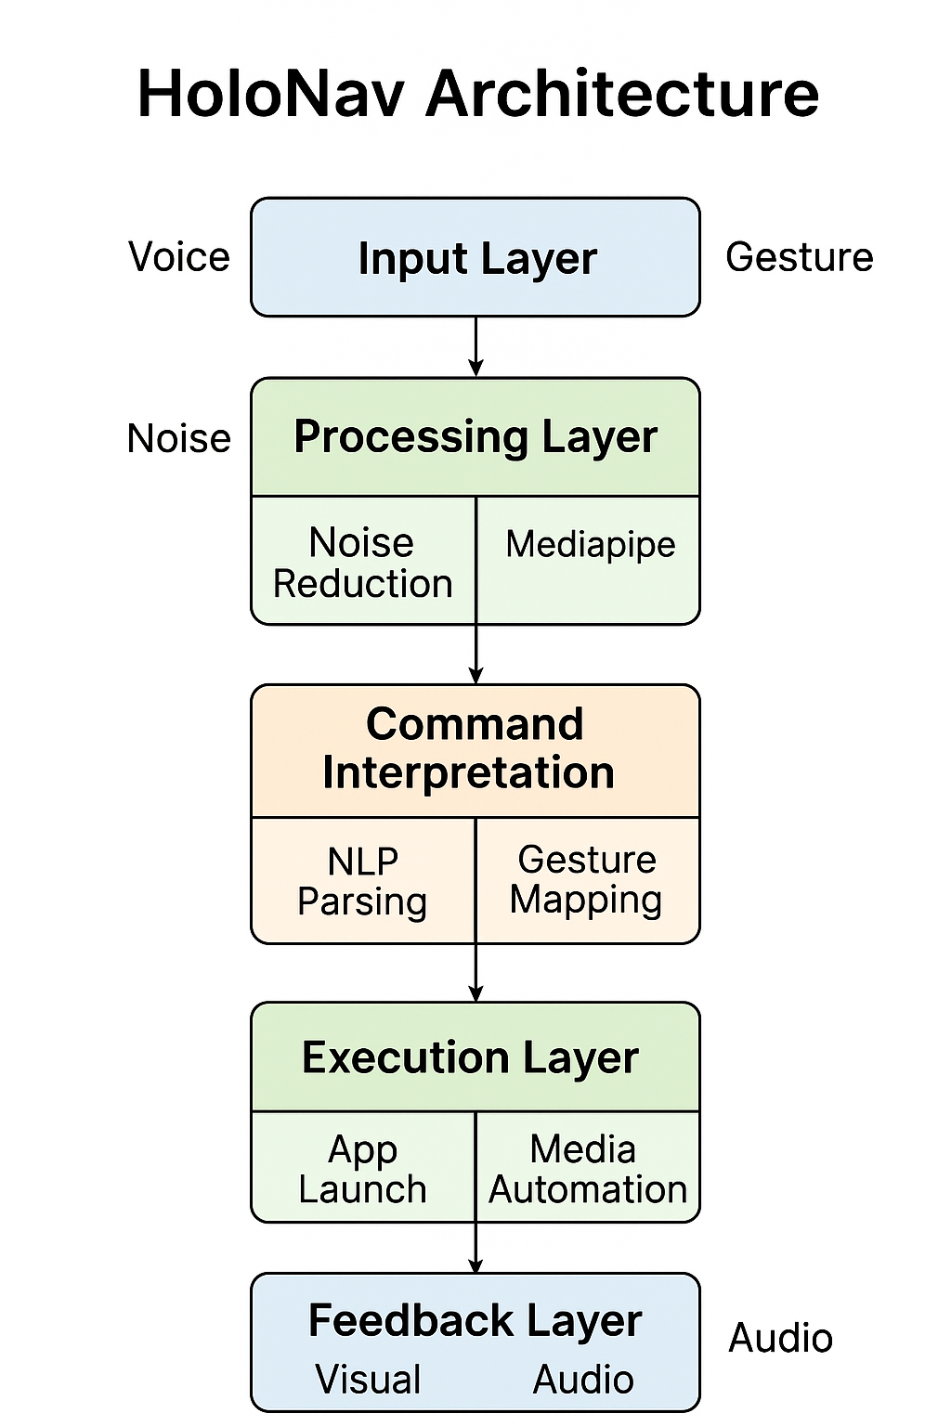

Slide 6
How It Works:
Camera Input: Webcam captures the user’s hand movements.
Hand Detection: Media Pipe detects the hand and tracks landmarks.
Gesture Classification: ML model classifies the gesture based on landmarks.
Ac on Mapping: Detected gestures are mapped to specific media ac one using Python automation (e.g., pyautogui).
Execution: Media player responds accordingly in real- me.

Slide 7
How HoloNav Works Inside
Voice Preprocessing
Gesture Detection
Command Translation
Smart noise control and accurate
speech-to-text for clear
commands
Media pipe helps us detect wrist
and shoulder positions to
understand gestures
Voice and hand gestures are
converted into
actions to control apps easily

Slide 8
Powering HoloNav: Key Algorithms
Speech Recognition (Google Speech-to-Text) Converts spoken words into commands (e.g., “Play Music” → opens YouTube music)
Pose Estimation (Media Pipe Pose) Detects body keypoints to recognize gestures (e.g., raise right hand → next slide).
Gesture Classification (Threshold Rules) Maps gestures into actions (e.g., both hands up → start slideshow).
Event Mapping Algorithm Converts recognized input into real system actions (e.g., “Calculator” → opens app).
Multimodal Fusion Algorithm Combines voice + gesture input for seamless control.

Slide 9
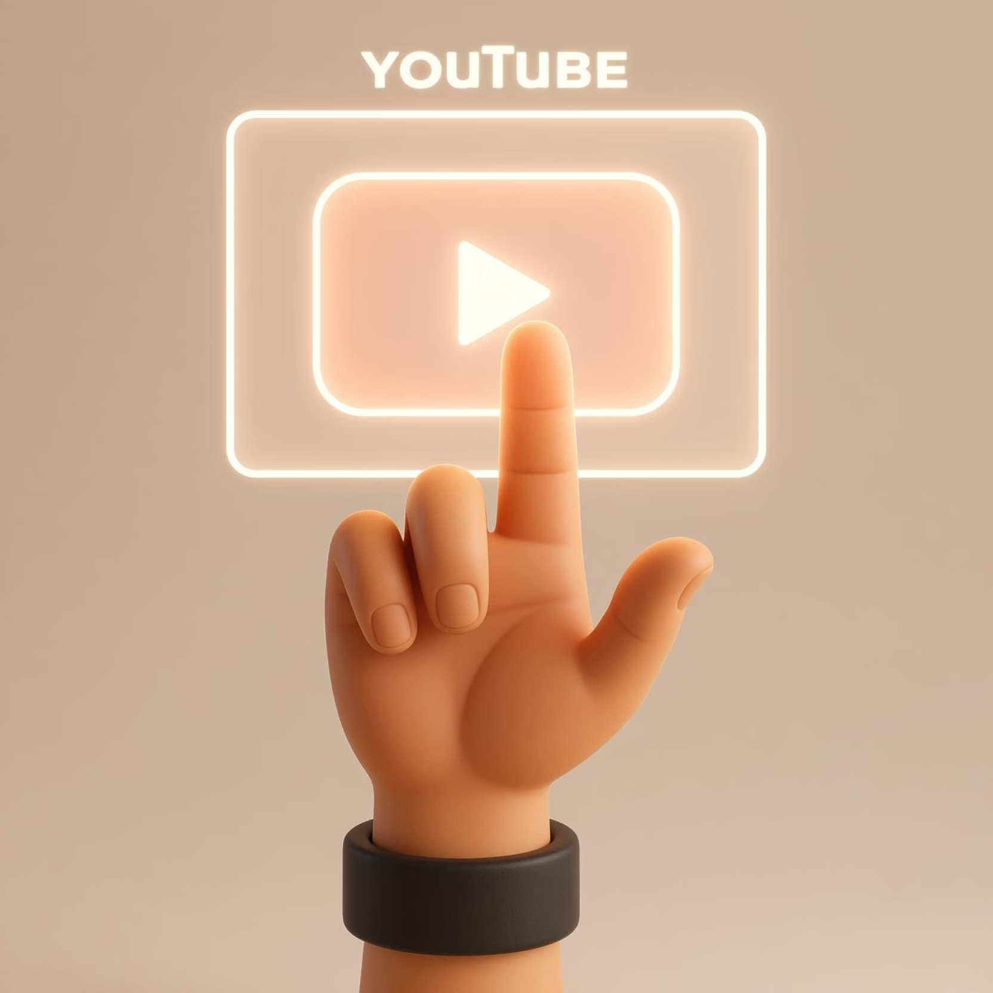
HoloNav: Real-World Capabilities
Voice-Controlled YouTube: Seamlessly play, pause, and search videos with simple voice commands.
Gesture-Driven PowerPoint: Navigate presentations (next, previous, start) using intuitive hand gestures
Reliable Automation: Demonstrated effective hands-free and voice-controlled automation across various applications
Our initial results confirm the viability of a truly touchless, futuristic control system

Slide 10
Beyond Today: HoloNav’s Future
AI Assistant Integration –Evolving into a natural conversational AI assistant for even more intuitive interactions.
Smart Home Ecosystem – Expanding control to integrated smart home devices, managing lights, fans, and AC with gestures and voice.
Augmented & Virtual Reality – Pioneering touchless control within immersive AR/VR environments for enhanced user experiences
Healthcare Applications – Implementing hygienic, touchless interfaces in medical settings for critical control and efficiency

Slide 11
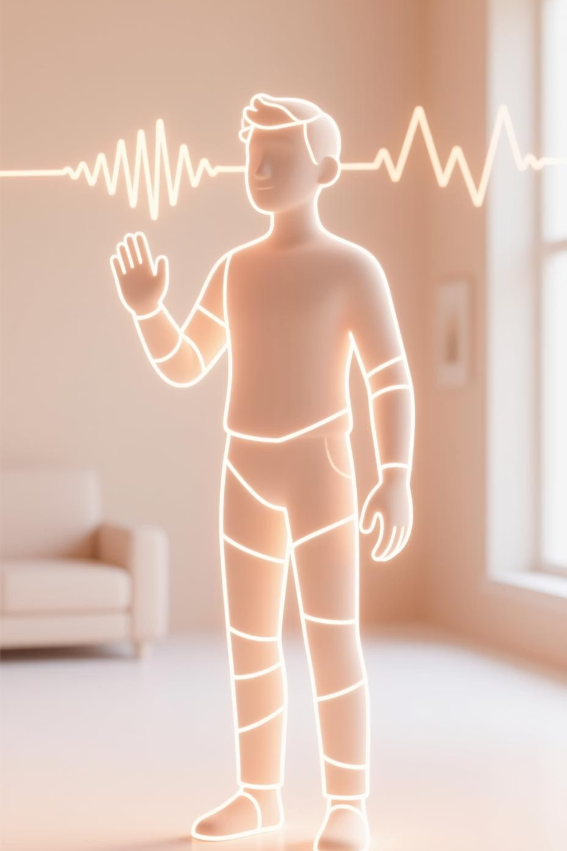
Conclusion:
This project shows how hand gestures can be used to control present and videos using computer vision.
By combining OpenCV, Media Pipe, and PyAuto GUI, the system tracks hand position and performs ac ones like next slide, previous slide, and play/pause without any physical input devices
It makes presents and media control hands-free, easy, and interactive, and can be useful for teachers, presenters, and remote workers.
In the future, more gestures like volume control, exit, and swipe navigation can be added to make it even more powerful.

